Slide 1

HOUSE PRICE PREDICTION

Slide 2
THE PURPOSE IS TO PREDICT HOUSING PRICE USING R-2 SCORE
WE TRAINED 4 MODELS, WHICH ARE PROVEN TO BE EFFECTIVE, TO PREDICT PRICES BASED ON HOUSES INFORMATION
Over 80 Input Variables: Information about houses
LINEAR REGRESSION GRADIENT BOOSTING BAGGING
RANDOM FOREST
Overall Quality
Output Variable: Housing Sales Price
Above-Grade Living Area
Size of garage in square feet
R-2 SCORE
-
CROSS VALIDATION SCORE
Original construction date
Neighbourhood
BEST MODEL
Lot size in square feet

Slide 3
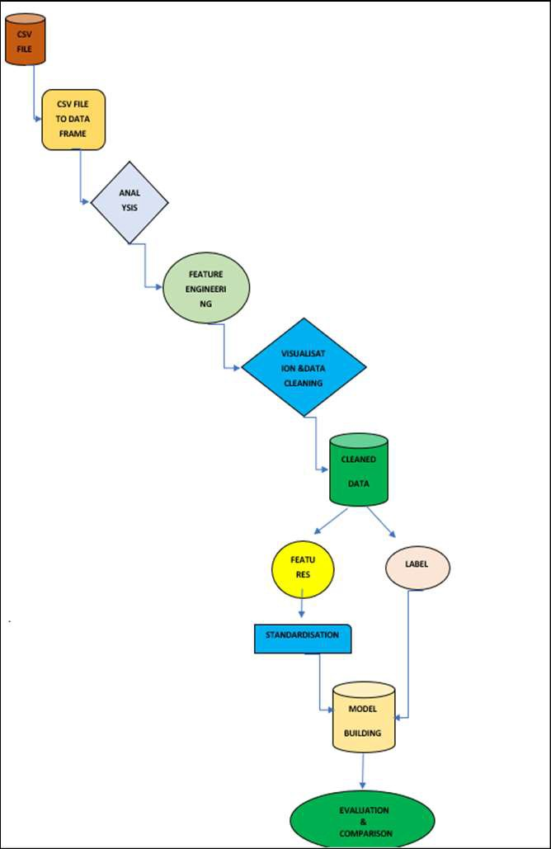
ARCHITECTURE
HERE WE DESCRIBE THE STEPS INVOLVED IN BUILDING MODEL
With the help of flow chart I sum up all the necessary steps
that are used in building machine learning models.

Slide 4
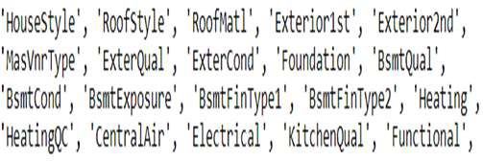
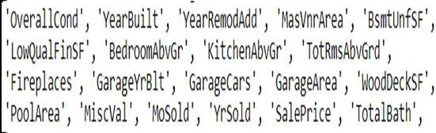
DEALING WITH DIFFERENT TYPES OF DATA
GROUPING DATA INTO DIFFERENT CATEGORIES CAN HELP TO SORT THROUGH IT AND ORGANIZE IT EFFECTIVELY
TYPES OF VARIBLE
TRANSFORMATION EXAMPLE
NUMERICAL
Just ensure that the variable is numeric: column.astype('float64’)
CATEGORICALLY
Using label encoder for encoding

Slide 5
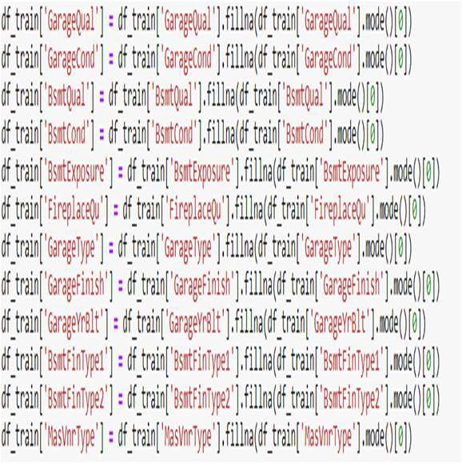
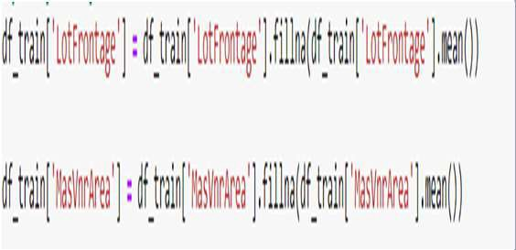
MISSING VALUE IMPUTATION OF TRAIN DATASET
FILLING MISSING VALUE WITH MEAN AND MODE
mode
mean

Slide 6
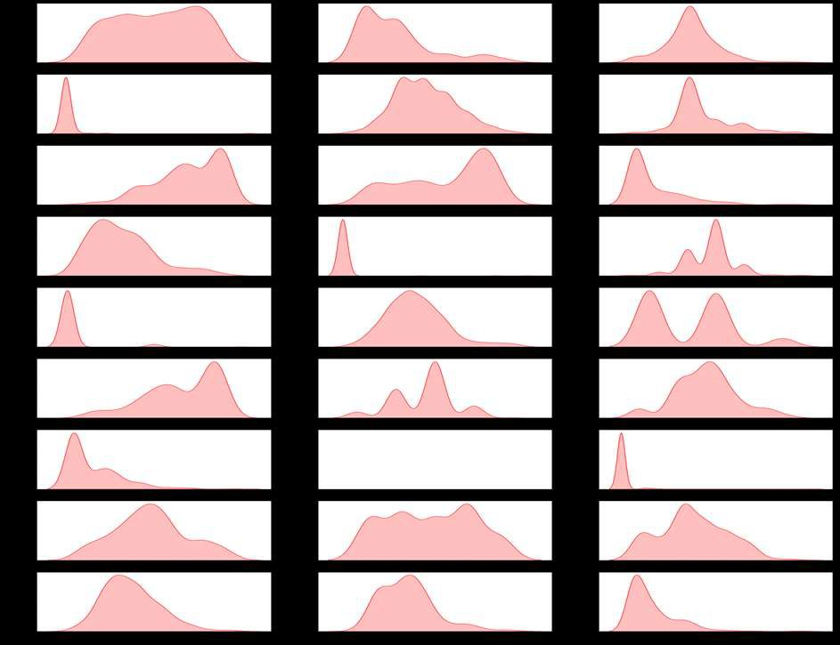
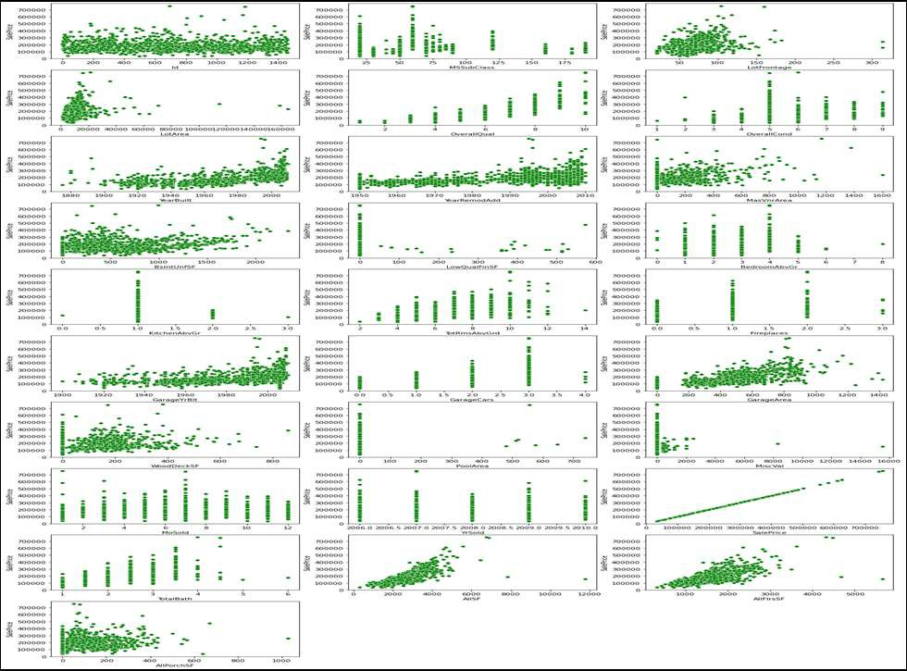
A GLANCE OF DATASET
EXPLORATING DATASET IS THE FOUNDATION OF THE FOLLOWING PRE-PROCESSING AND MODELING
Distributions of variables
Relationship between input and output variables
Some variables are significantly skewed that might need to be standardized
Outliers exist and some variables have strong linear relationship with price

Slide 7
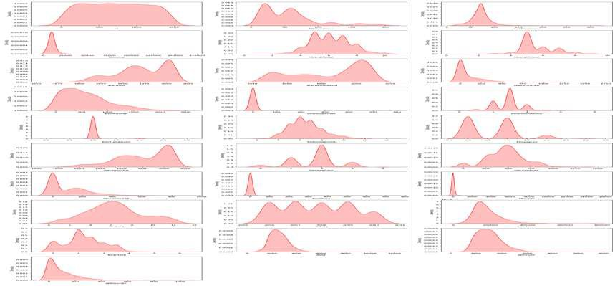
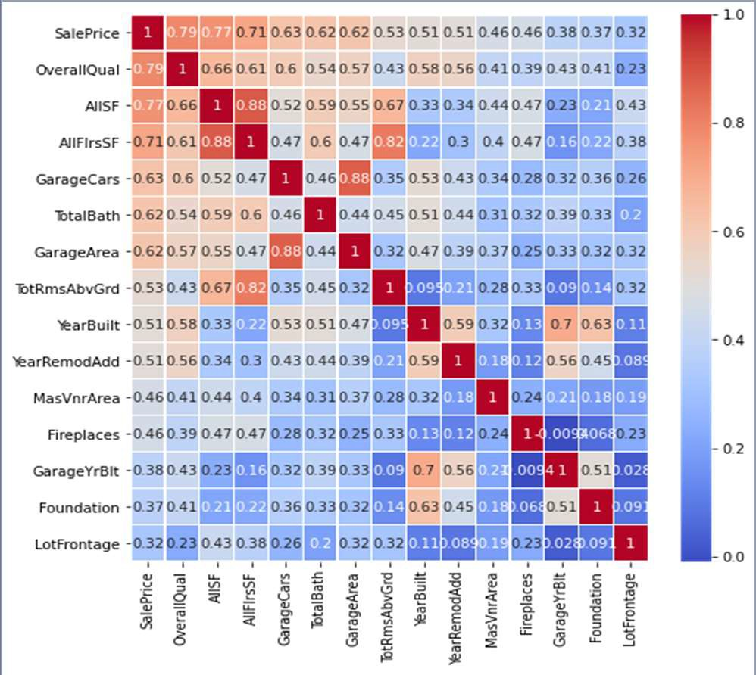
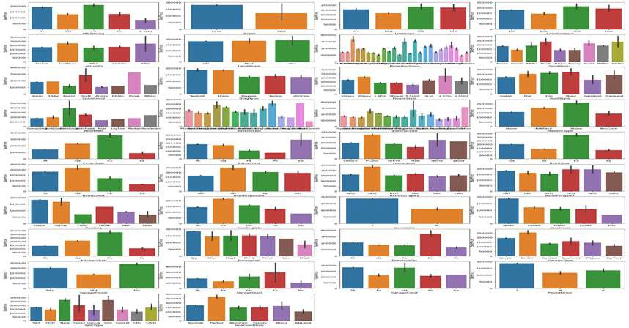
ANALYSIS
UNIVARIATE, BIVARIATE, MULTIVARIATE ANALYSIS TO STUDY RELATIONSHIP
Univariate
Multivariate
Bivariate

Slide 8
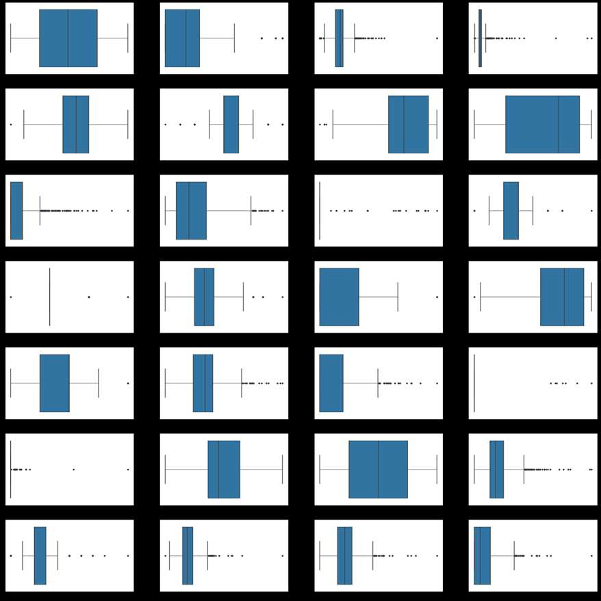
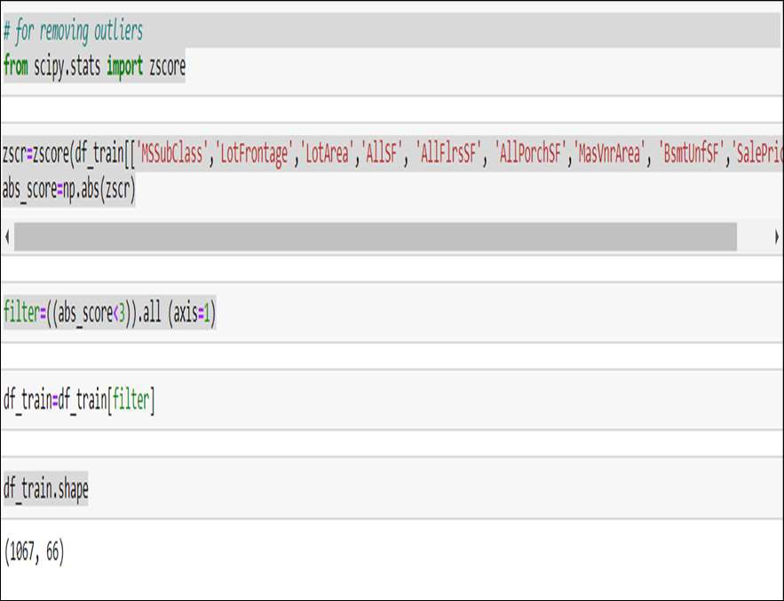
REMOVING OUTLIERS OF IMPORTANT - HIGHLY CORRELATED – FEATURES
FILTER OUT OUTLIERS IN IMPORTANT FEATURES THAT HAVE HIGH CORRELATION WITH SALES PRICE AND REMOVE THEM.
Using z score to remove outlier in the dataset along with target column.
Although after applying z-score there is outliers present keeping it as it cause more data loss.

Slide 9
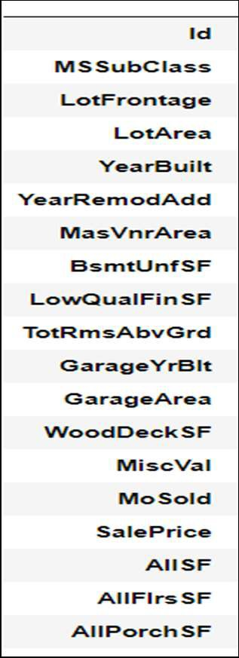
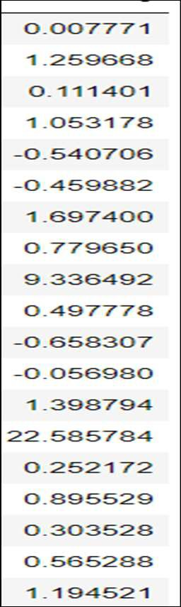
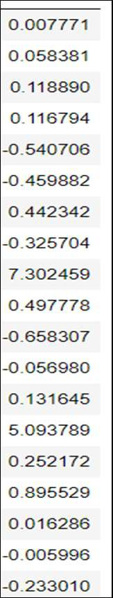
DEALING WITH SKEWNESS
APPLYING POWER TRANSFORMER TO REDUCE SKEWNESS
Skewed Data
Before Transformation
After Transformation

Slide 10

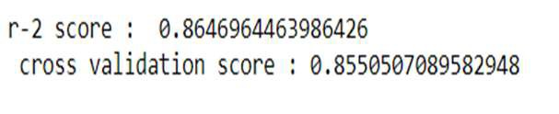
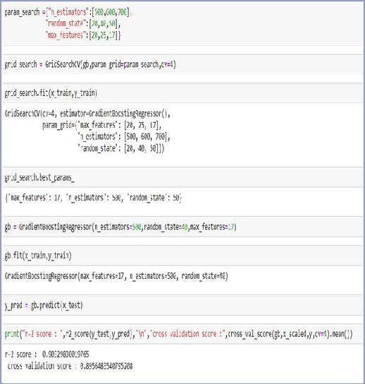
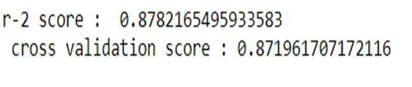

PRICE PREDICTION BY DIFFERENT MODEL
MODEL COMPARISON AND PRICE PREDICTION
MODEL
GRADIENT BOOSTING
HYPER PARAMETER TUNING
BAGGING
GRADIENT BOOSTING
RANDOM FOREST
LINEAR REGRESSION

Slide 11
Project Submitted By :
Arun Sharma

